Slide 1



Software engineering (Undergraduate)
Chapter 8 Requirements engineering
Course Name software engineering
CSC 3114
(Undergraduate)
M. Mahmudul hasan
Assistant Professor, CS, AIUB
http://www.dit.hua.gr/~m.hasan

Slide 2
Requirements engineering phases
Slide-2
Inception
Elicitation
Analysis and Elaboration
Negotiation
Specification
Validation
Requirements Management
MMH

Slide 3
inception
Slide-3
Inception—ask a set of questions that establish:
basic understanding of the problem
the people who want a solution (identify the stakeholder)
the nature of the solution that is desired
the effectiveness of preliminary communication and collaboration between the customer and the developer
what will be the economic benefit of a successful solution
MMH

Slide 4
Requirements elicitation
Slide-4
Elicitation—elicit requirements from all stakeholders
Interviewing related stakeholder with pre-determined questionnaire
meetings are conducted and attended by both software engineers and customers
Observation and ethnography
a "definition mechanism" (can be work sheets, flip charts, or wall stickers or an electronic bulletin board, chat room or virtual forum) is used in collecting requirements
the goal is:
to identify the problem
propose elements of the solution
specify a preliminary set of solution requirements
MMH

Slide 5
Requirements Elaboration
Slide-5
Building the Analysis Model:
Scenario-based elements
Functional—processing narratives for software functions
Use-case—descriptions of the interaction between an “actor” and the system
Class-based elements
Implied by scenarios
Behavioral elements
State diagram
Flow-oriented elements
Data flow diagram, Sequence diagram, Activity Diagram
MMH

Slide 6
Requirements Analysis
Slide-6
Requirements analysis
specifies software’s operational characteristics
indicates software's interface with other system elements
establishes constraints that software must meet
Requirements analysis allows the software engineer or requirements analyst to:
elaborate on basic requirements established during earlier requirement engineering tasks
build models that depict user scenarios, functional activities, problem classes and their relationships, system and class behavior, and the flow of data as it is transformed.
MMH

Slide 7
Requirements Analysis
Slide-7
Requirements Analysis Modeling
Analysis models are build using requirements elicited from the customer
Analysis modeling results in the first technical representation of the system
Analysis modeling provides the developer and the customer with the means to access quality once S/W is built
During modeling, the S/W Engineer should focus on WHAT rather than on HOW
Requirements Analysis Modeling Objectives
Describe what the Customer requires
Establish a basis for the creation of a S/W design
Define a set of requirements that can be validated once the software is built
MMH

Slide 8
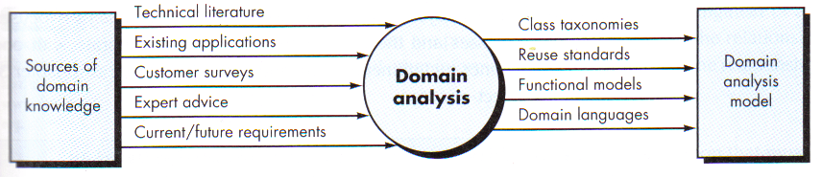
domain Analysis
Slide-8
Define the domain to be investigated
Collect a representative sample of applications in the domain
Analyze each application in the sample
Develop an analysis model for the objects
MMH

Slide 9
Data modelling
Slide-9
Indicates how data objects relate to one another
Data object is a representation of almost any composite information that must be understood by S/W. Composite information means number of different attributes and properties. Length or Breadth is not a Data Object, Dimension is a Data Object (as it is a composition of Length, Breadth & Height)
external entities (e.g., printer, user, sensor)
Things (e.g., reports, displays, signals)
occurrences or events (e.g., interrupt, alarm)
roles (e.g., manager, engineer, salesperson)
organizational units (e.g., division, team)
Places (e.g., manufacturing floor)
structures (e.g., employee record)
MMH

Slide 10
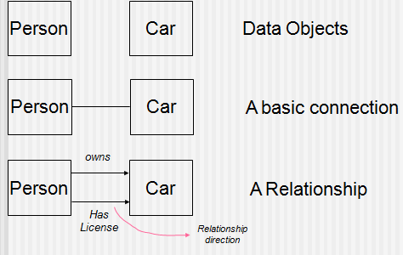
Data objects & relationships
Slide-10
Data objects are connected to one another in different ways.
MMH

Slide 11
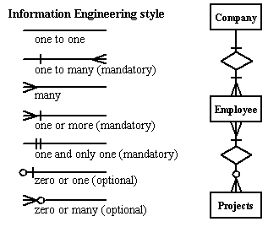
Cardinality – erd notation
Slide-11
MMH

Slide 12
Classes categorization
Slide-12
Boundary Classes (UI)
Models the interaction between the system’s surroundings and its inner workings
User interface classes, Concentrate on what information is presented to the user, don’t concentrate on user interface details
System / Device interface classes, concentrate on what protocols must be defined. don’t concentrate on how the protocols are implemented
Entity Classes
Models the key concepts of the system
Usually models information that is persistent
Contains the logic that solves the system problem
Can be used in multiple behaviors
MMH

Slide 13
Classes categorization
Slide-13
Control Classes
Controls and coordinates the behavior of the system
A control class should tell other classes to do something and should never do anything except for delegating (directing) the work to other classes
Control classes separate boundary and entity classes
MMH

Slide 14
Classes Categorization
Slide-14
MMH

Slide 15
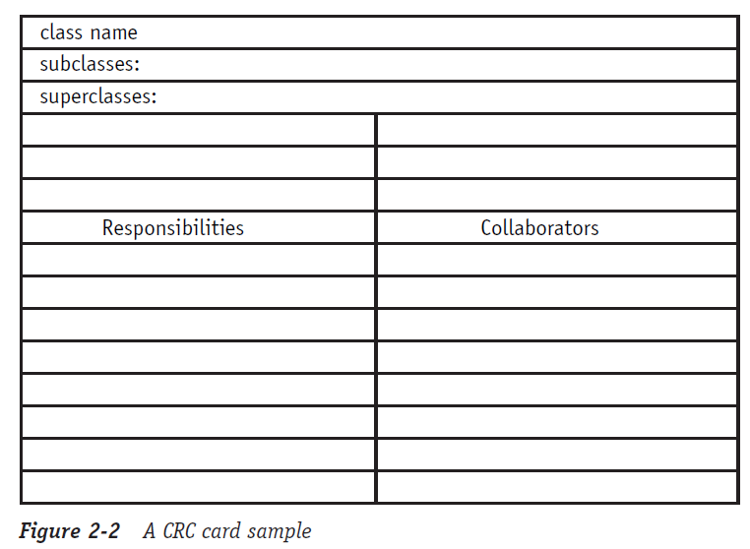
Crc card
Slide-15
Class Responsibility Collaboration
CRC goals: provide the simplest possible conceptual introduction to OO design
MMH

Slide 16
Crc card
Slide-16
A CRC card is a 3-x-5" or 4-x-6" lined index card.
The physical nature of the cards emphasizes the division of responsibility across objects.
The physical size of the cards also helps to establish limits for the size and complexity of the classes.
The CRC card technique does not use the UML, instead it is used to discover information about classes that is then placed into a UML Class diagram.
The body of the card is divided in half.
The left column/half lists the responsibilities of the class
The right column/half lists the other objects that it works with, the collaborators, to fulfill each responsibility.
MMH

Slide 17
Requirements negotiation
Slide-17
Identify the key stakeholders
These are the people who will be involved in the negotiation
Determine each of the stakeholders “win conditions”
Win conditions are not always obvious
Negotiate/Prioritization
Work toward a set of requirements that lead to “win-win”
MMH

Slide 18
Requirements validation
Slide-18
Is each requirement consistent with the overall objective for the system/product?
Have all requirements been specified at the proper level of abstraction?
Is the requirement really necessary or does it represent an add-on feature that may not be essential to the objective of the system?
Is each requirement unambiguous?
Do any requirements conflict with other requirements?
Is each requirement achievable in the technical environment that will house the system or product?
Is each requirement testable, once implemented?
Does the requirements model properly reflect the information, function and behavior of the system to be built.
Have requirements patterns been used to simplify the requirements model. Have all patterns been properly validated? Are all patterns consistent with customer requirements?
MMH

Slide 19
The Requirements Baseline
Slide - 9
A requirements baseline is a set of requirements that has been reviewed and agreed upon and serves as the basis for further development.
A meaningful baselining process gives all the major stakeholders confidence in the following ways:
Customer management or marketing is confident that the project scope won’t explode out of control, because customers manage the scope change decisions.
User representatives have confidence that the development team will work with them to deliver the right solution, even if they didn’t think of every requirement before construction began.
Development management has confidence because the development team has a business partner who will keep the project focused on achieving its objectives and will work with development to balance schedule, cost, functionality, and quality.
Business analysts and project managers are confident that they can manage changes to the project in a way that will keep chaos to a minimum.
Quality assurance and test teams can confidently develop their test scripts and be fully prepared for their project activities.

Slide 20
references
Slide - 20
R.S. Pressman & Associates, Inc. (2010). Software Engineering: A Practitioner’s Approach.
Kelly, J. C., Sherif, J. S., & Hops, J. (1992). An analysis of defect densities found during software inspections. Journal of Systems and Software, 17(2), 111-117.
Bhandari, I., Halliday, M. J., Chaar, J., Chillarege, R., Jones, K., Atkinson, J. S., & Yonezawa, M. (1994). In-process improvement through defect data interpretation. IBM Systems Journal, 33(1), 182-214.

